Slide 1
Design review
Sprint 5 — June 24, 2022

Slide 2
Agenda
Health Hub
Veterans research findings
Next steps
1095-B
Content office hours
Accessibility review
Notifications flow

Slide 3
Health Hub — Veterans IA Tree Test Research Findings

Slide 4
Background and goals
As the team considers where to include the Health Apartment on VA.gov, this research is an effort to update and improve the benefits-related information architecture of VA.gov.
Goals:
How we might create an experience that allows Veterans to easily find the content and tools they need based on where they are in their VA health care journey:
learning about the benefit
applying for the benefit
getting started with the benefit
or managing their care and health benefits?
Sprint 5 — June 24, 2022

Slide 5
Veteran journey & OCTO-DE
How this research maps back to Veteran journey:
Primary point in the Veteran journey: “Taking care of myself”
Secondary points: “Starting up,” “Putting down roots,” “Retiring,” and “Aging”
OCTO-DE goals this research supports:
Veterans and their families can find a single, authoritative source of information
Veterans can manage their health services online
Logged-in users have a personalized experience, with relevant and time-saving features

Slide 6
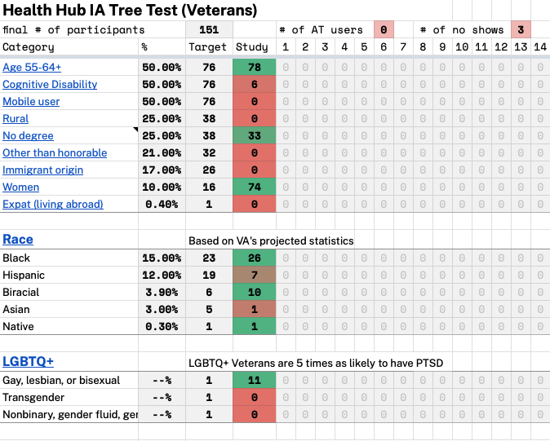
Participant Demographics
Hypothesis 0: 51 completed
Hypothesis 1: 50 completed, 3 abandoned
Baseline: 47 completed
81 participants are enrolled in VA health care.
Findings may not include the range of perspectives from the following underserved Veteran groups:
Have a cognitive disability
Live in a rural area
Have other than honorable discharge
Are of immigrant origin
Idefinity as Latinx or Asian
Use assistive technology
Participant tracker

Slide 7
Initial findings
Hypothesis 1 performed better on “get” tasks
Hypothesis 0 performed better on “manage” tasks
For participants without VA health care, Hypothesis 1 performed better
For both hypotheses, Task 9 had the highest success rate*
Task 5 had the lowest success rate for both hypotheses*
*Task 6 was eliminated from analysis

Slide 8
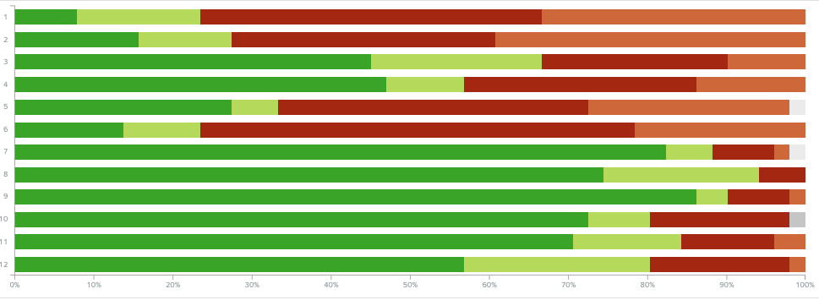
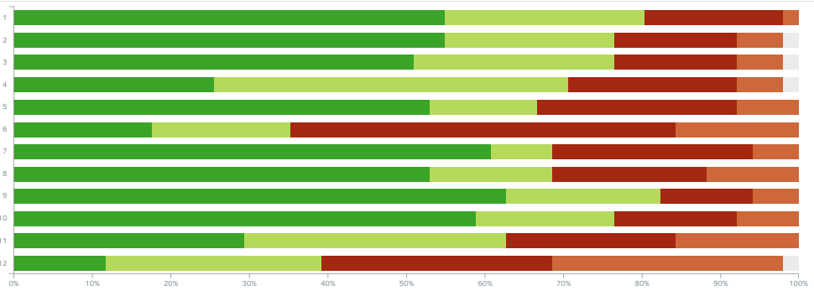
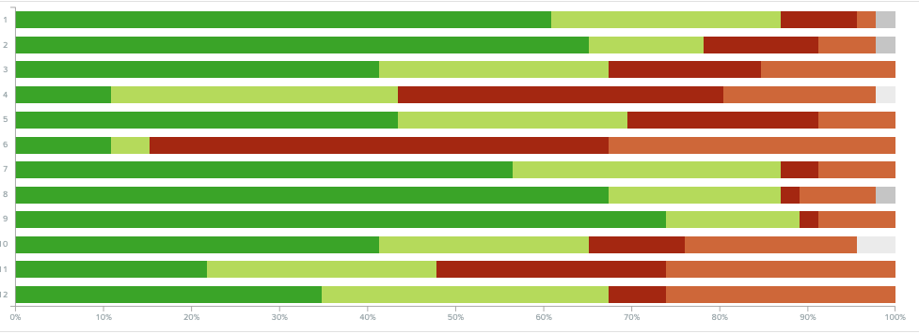
Initial finding #1
Overall, Hypothesis 1 performed better on “get” tasks
First click after “VA benefits and health care”
Task 1 (Eligibility): “Health care” (71%)
“Service member benefits” (20%)
Task 2 (Enrollment): “Health care” (78%)
“Service member benefits” (6%)
Task 3 (Dental): “Health care” (86%)
“Service member benefits” (12%)
Task 4 (Mental health): “Health care” (78%)
“Service member benefits” (12%)
Task 5 (Copay): “Health care” (88%)
“Service member benefits” (4%)
Task 11 (Community care): “Health care” (90%)
“Community providers” (4%)
Hypothesis 0
Hypothesis 1
Baseline

Slide 9
Initial finding #2
Hypothesis 0 performed better on “manage” tasks
First click after “VA benefits and health care”
Task 7 (Records): “My Health” (65%)
“Records” (33%)
Task 8 (Billing): “My Health” (84%)
“Service member benefits” (4%)
Task 9 (Prescriptions): “My Health” (90%)
“Service member benefits” (2%)
Task 10 (Messaging): “My Health” (86%)
“VA health” (8%)
Task 12 (Travel pay): “My Health” (86%)
“Service member benefits” (6%)
Hypothesis 0
Hypothesis 1
Baseline

Slide 10
Initial finding #3
For participants without VA health care, Hypothesis 1 performed better.
With the high success rate of “get” tasks, it makes sense that participants without health care
In both hypotheses, participants without health care performed had greater success completing the “get” tasks.

Slide 11
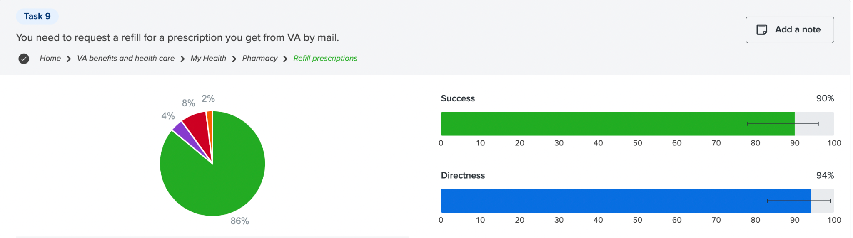
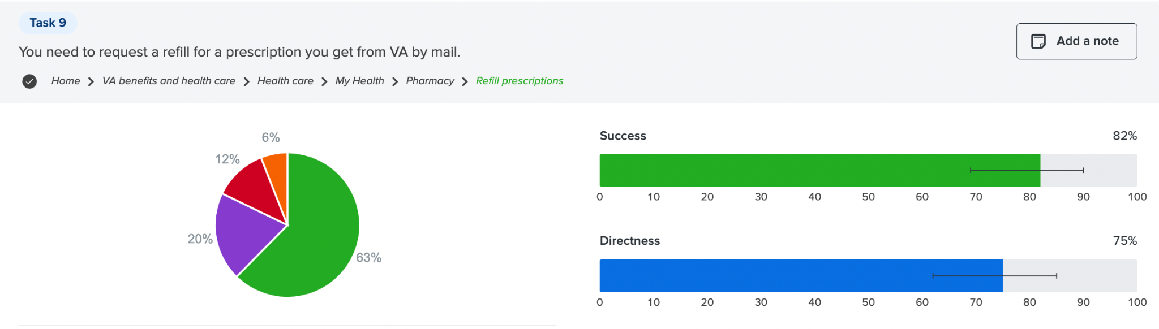
Initial finding #4
Task 9 had the highest success rate
Hypothesis 0
Hypothesis 1

Slide 12
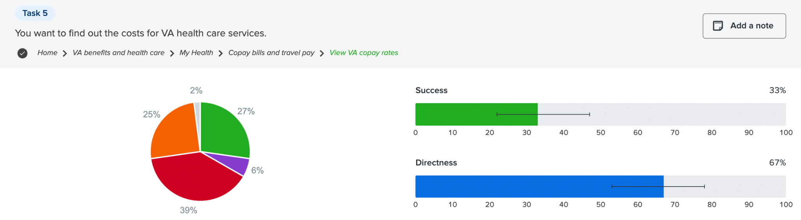
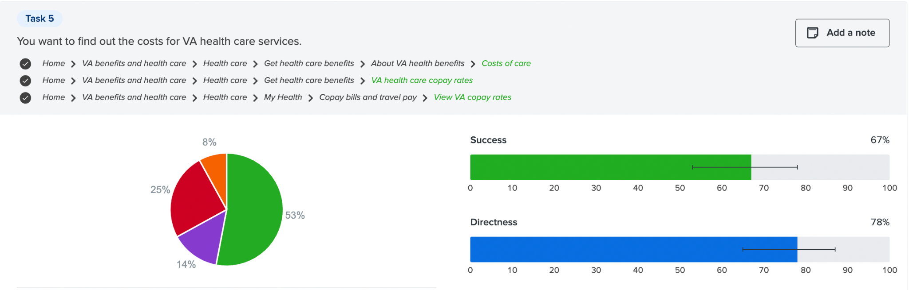
Initial finding #5
Task 5 had the lowest success rate
Hypothesis 0
Hypothesis 1

Slide 13
More to come…
June 17: Recruiting more caregivers began
July 5: Estimated close of caregivers studies
July 8: Design Review—Complete research synthesis (with recommendations) with Veterans and Caregivers

Slide 14
1095-B

Slide 15
Updates:
Content/Design review and approval
Accessibility Analysis
Notifications: Determining best course of action.

Slide 16
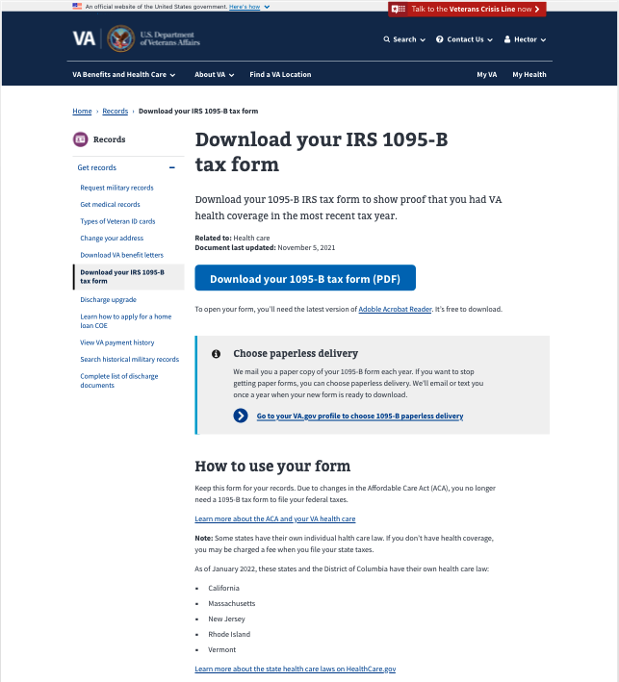
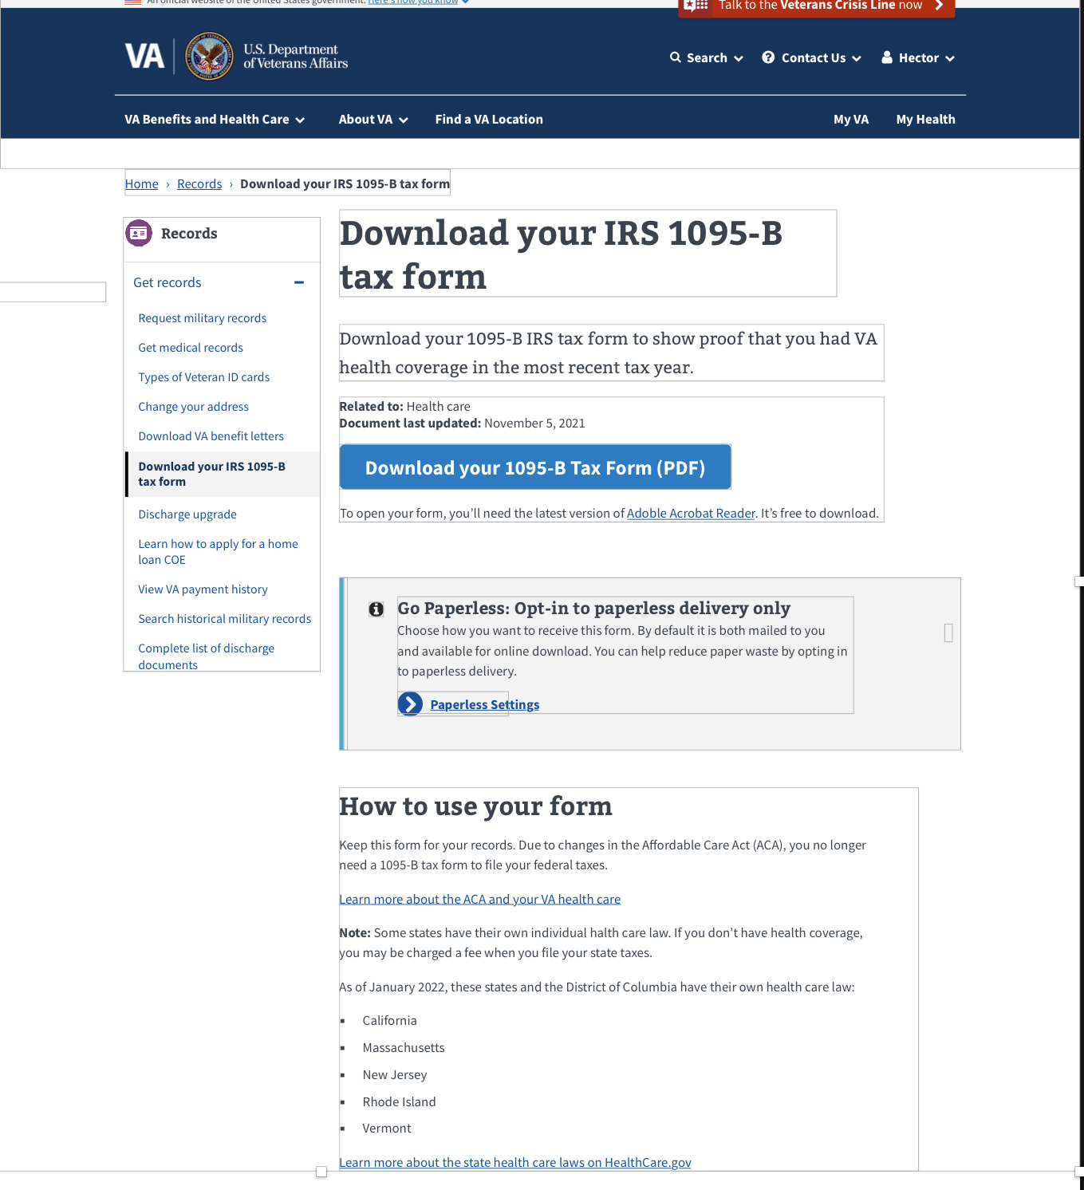
Content Review/Approval
The design updates have been reviewed for content and design and approved by the Sitewide & IA team
Some minor edits to copy have been made
“Information Alert Box” component deemed the appropriate component for use in this case.
“Go Paperless….” copy determined to be effective and appropriate language.

Slide 17
Accessibility Analysis
The team reviewed the populated 1095-B PDF document with Angela Fowler.
The document in its original state is accessible to the screen reader, but following processing/data population, it loses that accessibility
Next step is to understand what happens during document flattening that makes content inaccessible and solutions.
Options to investigate:
Create pdf in API without flattening (preferred)
Use HTML version instead of PDF version of 1095-B form
Store entire PDFs in database as sent to us by Enrollment System
Generate our own PDF replica from scratch

Slide 18
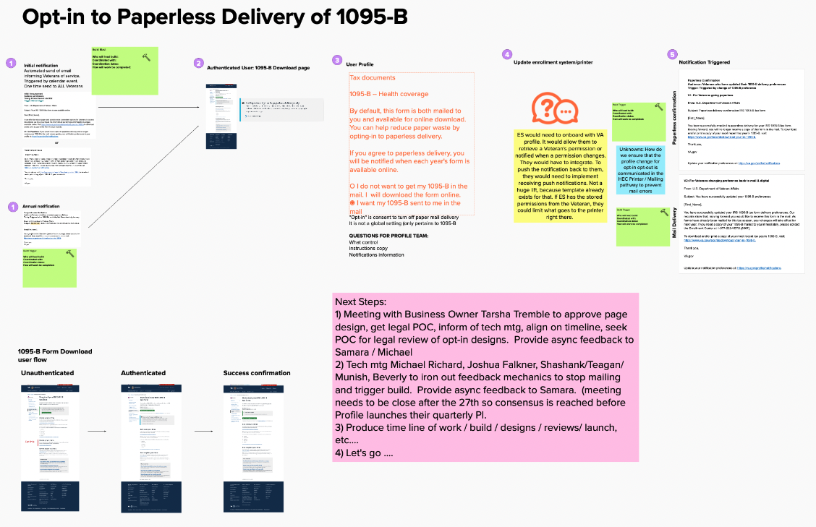
Notifications Process Map
6/16 spoke with Beverly Nelson, VANotify
6/17 spoke with Samara Strauss, VA Profile
6/23 synced with VANotify & Profile teams to discuss building triggers (Beverly Nelson, Michael Richard)
Built process map based on details around flow that we received from VANotify & Profiles team.
Annotated communication plan with government legal requirements.
Outlined next steps that will need to be taken for technical on our side and profiles teams
View Mural Board

Slide 19

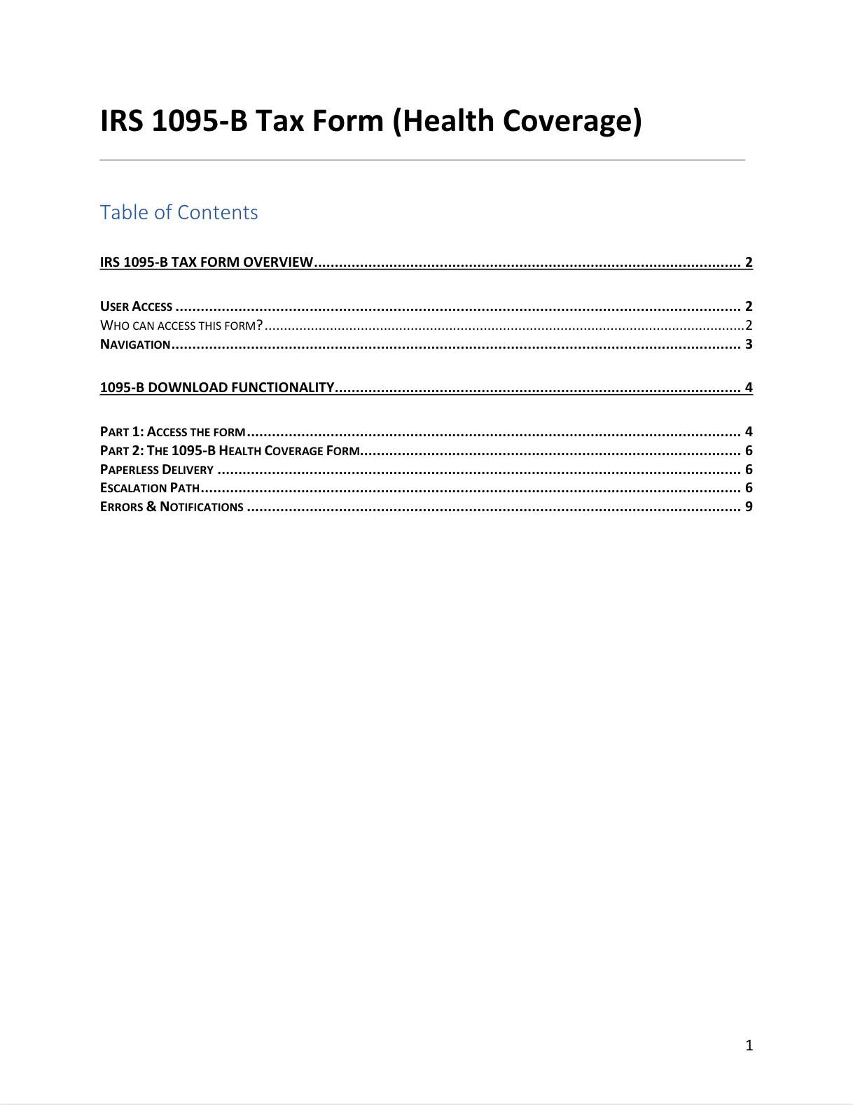
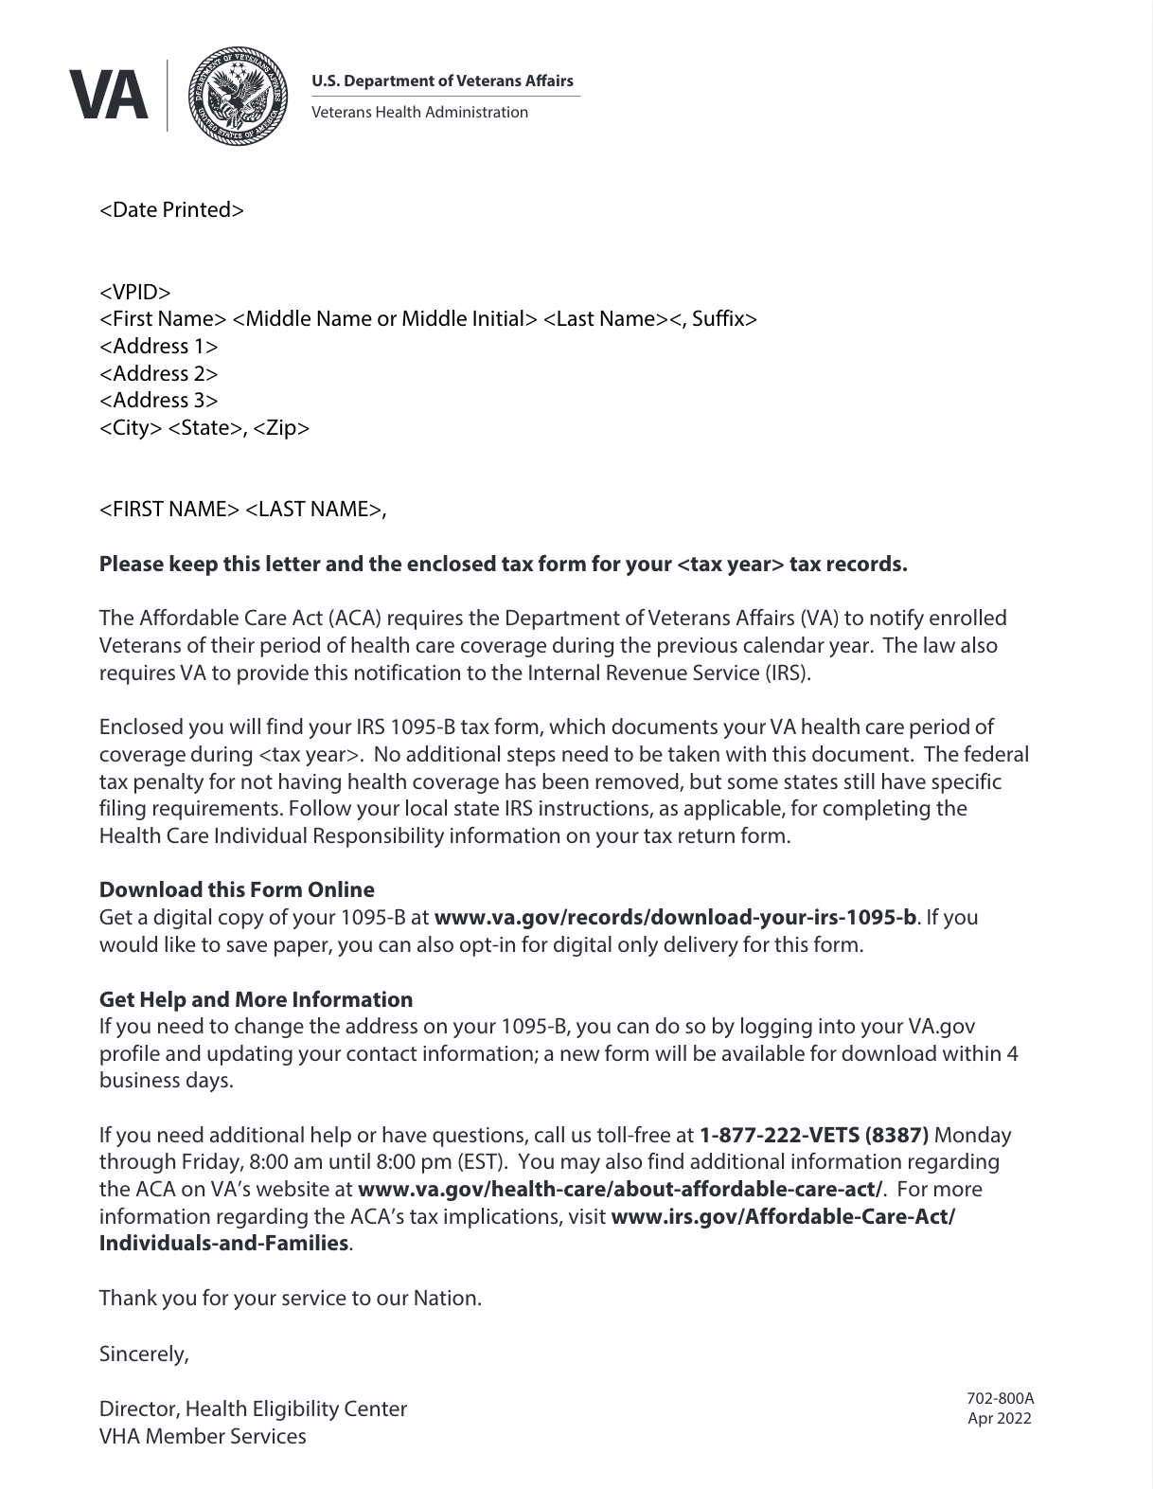
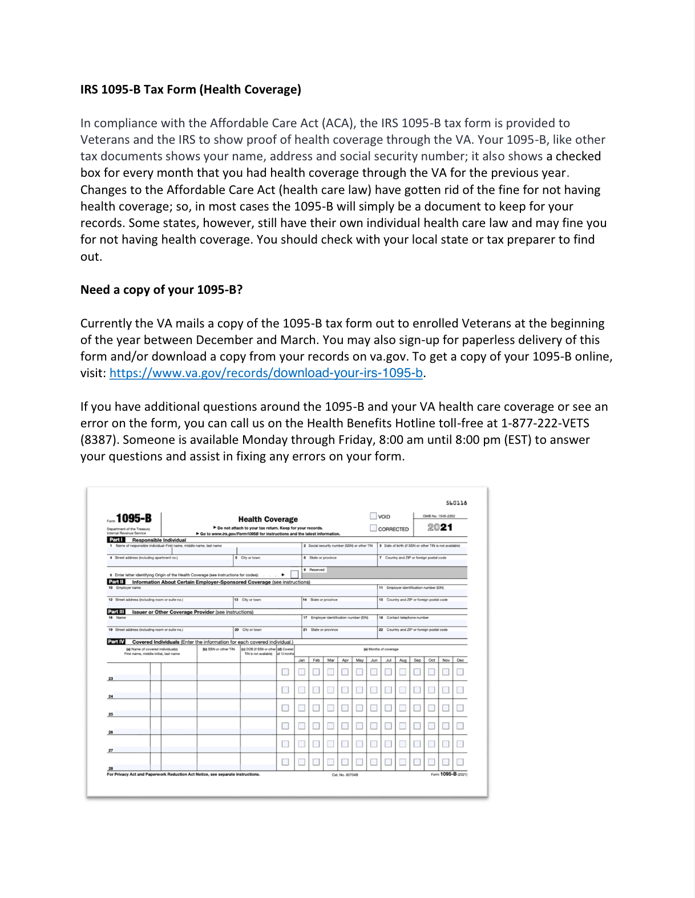
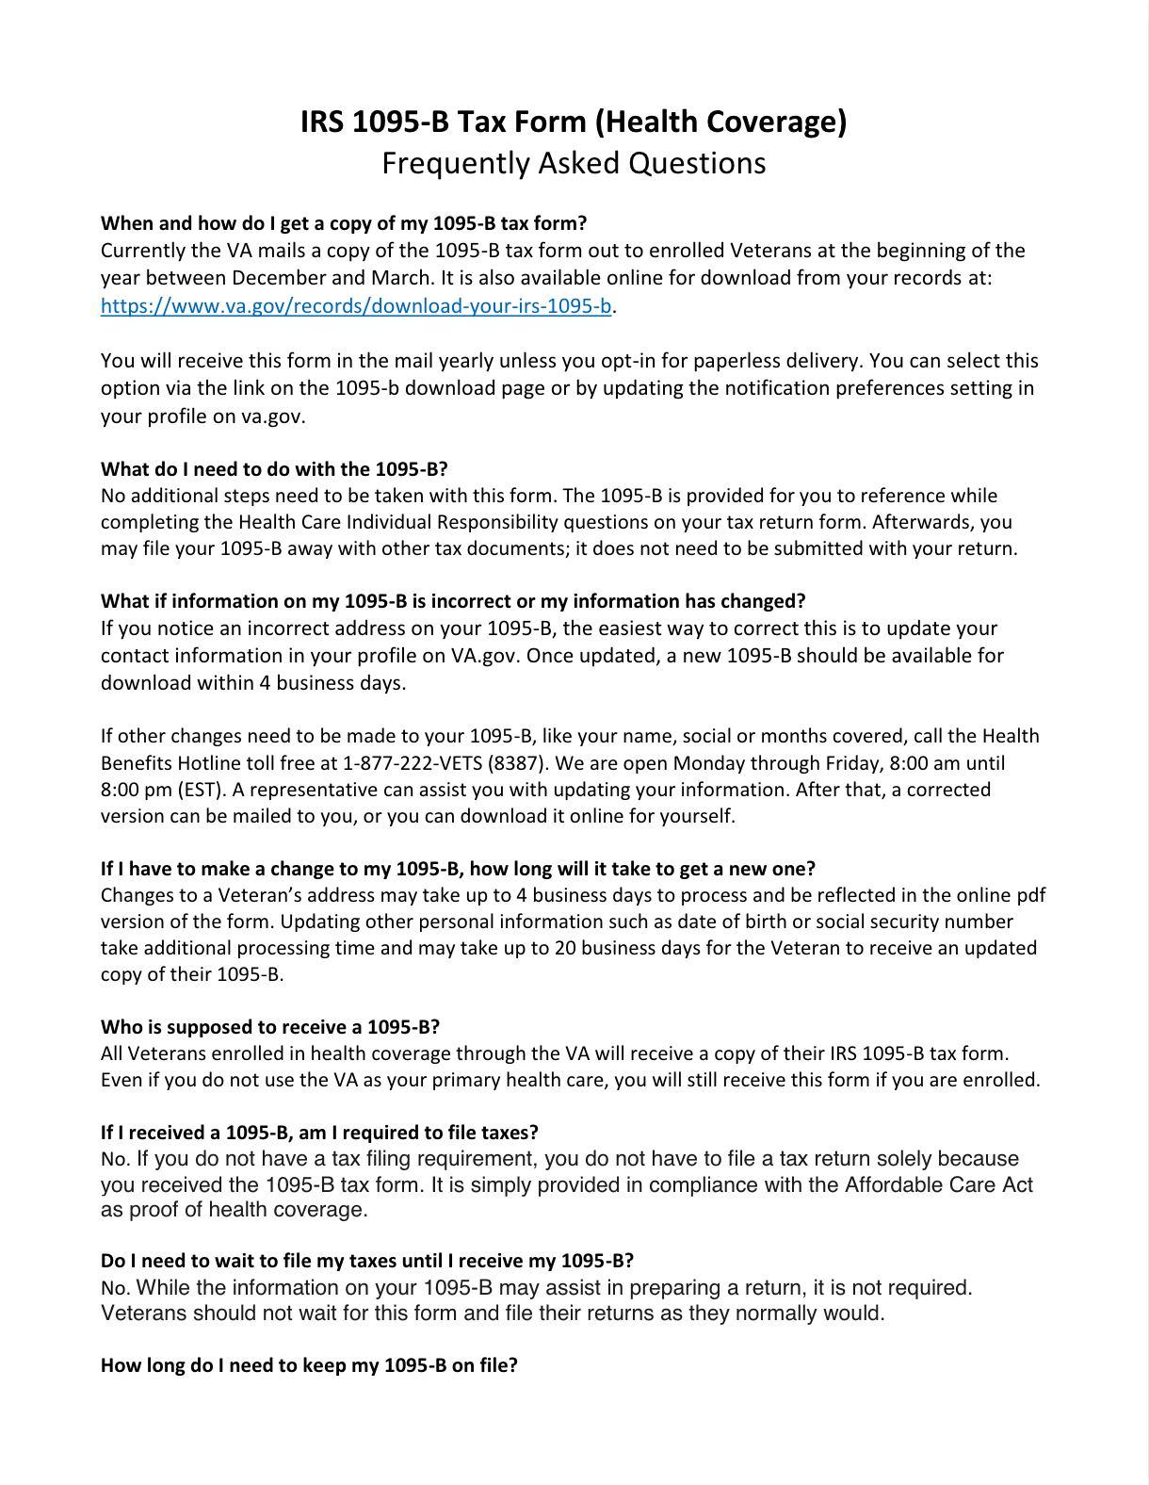
Updated documentation
HEC Documents
Product Guide:
Call Center Review
Cover Letter
https://mostudio.box.com/s/jaqtxzg1vwbgth1luh9lbzuum33ji18b

Slide 20
Next Steps
Send copy and designs to Tarsha for review (if needed)

